Slide 1
Cool T-Shirts– Attribution Queries based on this Codecademy project
CoolTShirts sells shirts of all kinds, as long as they are T-shaped and cool.
Recently, CTS started a few marketing campaigns to increase website visits and purchases. Using touch attribution, they’d like to map their customers’ journey: from initial visit to purchase.
They can use that information to optimize their marketing campaigns.

Slide 2

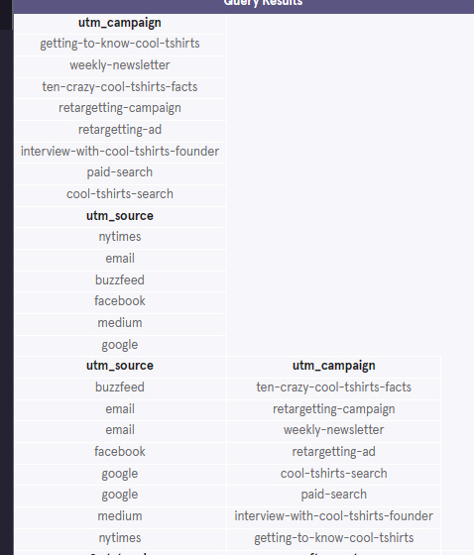

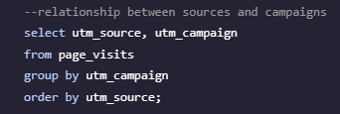
Q1 : How many campaigns and sources does CoolTShirts use? Which source is used for each campaign?

Slide 3

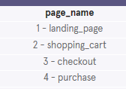
Q2 : What pages are on the CoolTShirts website?

Slide 4
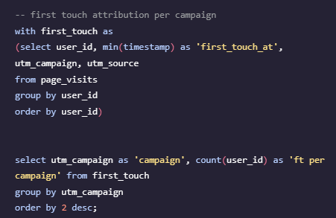
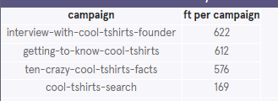
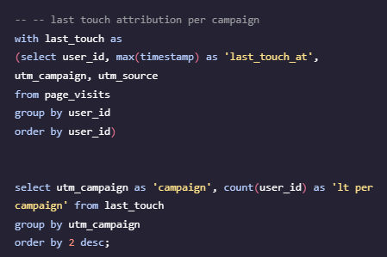
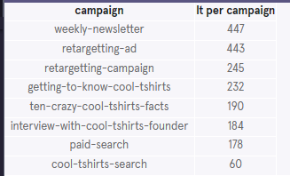
Q3 : How many first touches is each campaign responsible for?
Q4 : How many last touches is each campaign responsible for?

Slide 5
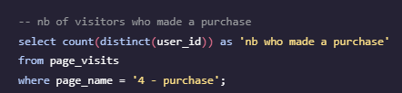

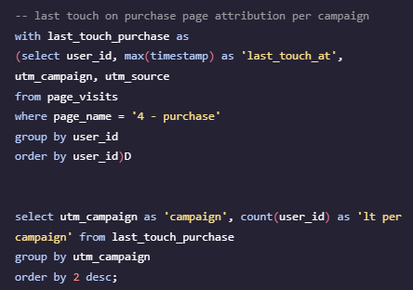
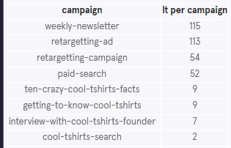
Q5 : How many visitors make a purchase?
Q6 : How many last touches on the purchase page is each campaign responsible for?

Slide 6
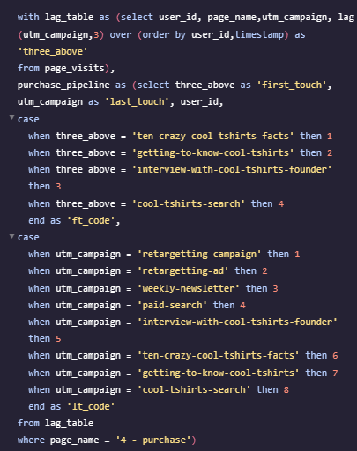
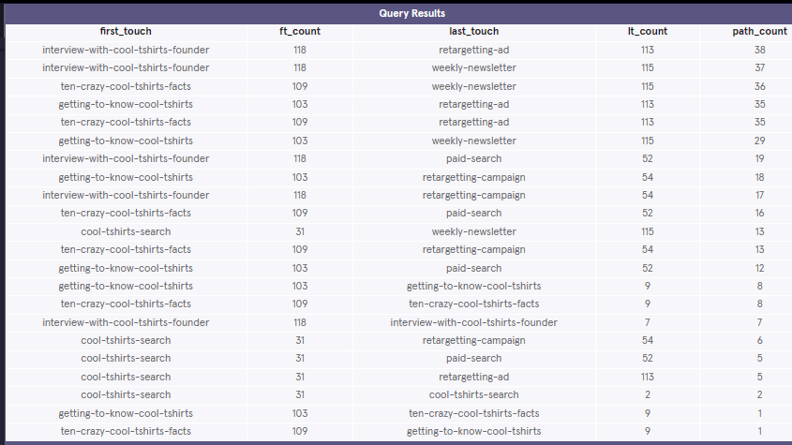
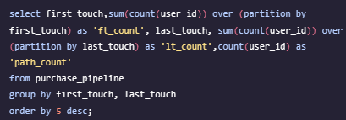
Q7: CoolTShirts can re-invest in 5 campaigns. Given your findings in the project, which should they pick and why?
Campaigns are of two types : approach (typically leading to first touch) and conclusion (typically leading to purchase). Both work together to at the end generate a purchase. We need to invest in both types of campaigns and pay attention to how they work hand in hand.
For this, we designed a query that displays the paths of approach + conclusion campaigns ending by the most purchases. On base of this query's results, we chose : 'interview-with-cool-tshirts-founder', 'ten-crazy-cool-tshirts-facts', 'getting-to-know-cool-tshirts' (approach), 'retargetting-ad', 'weekly-newsletter' (conclusion). The paths it allows us to cover end-to-end are highlighted below, they are applicable to about 65% of the purchase cases.

